Slide 1


Training Day 1

Slide 2
AGENDA
Basic Concepts of Data Warehouse ETL Process
BODS Overview
Architecture / tool & functions Questions

Slide 3
DATA WAREHOUSE

Slide 4
WHAT IS DATA WAREHOUSING?
“A data warehouse is a subject-oriented, integrated, nonvolatile, time-variant collection of data in support of management's decisions.”
-WH Innmon
A data warehouse is constructed by integrating data from multiple heterogeneous sources.
It supports analytical reporting, structured and/or ad hoc queries and decision making.

Slide 5
WHY DATA WAREHOUSING ?
To formulate effective business, marketing and sales strategies.
To precisely target promotional activity.
To discover and penetrate new markets.
To successfully compete in the marketplace from a position of informed strength. To build predictive rather than retrospective models.

Slide 6
DATA WAREHOUSE STRATEGIES
The strategy for developing a data warehouse can be broken down into four steps:
Educate yourself: We recommend getting Business Intelligence Road map and reading it cover to cover before you start.
Determine business requirements: Not all data warehouses are the same. You need to understand why the requestor needs a data warehouse.
Make a timeline: Break up those business objectives mentioned above into 3-month incremental deliverables.
Choose architecture, methodology, and technology and compile a staff (and/or consultancy): You'll need to meet you business objectives as well as build your structures scalable so that you can add-on easily to meet future requirements.

Slide 7
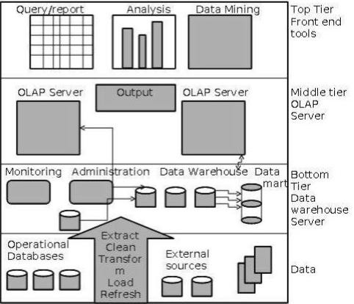
DATA WAREHOUSE ARCHITECTURE

Slide 8
DATA WAREHOUSE ARCHITECTURE
Generally a data warehouses adopts a three-tier architecture:
Bottom Tier − The bottom tier of the architecture is the data warehouse database server. It is the relational database system. We use the back end tools and utilities to feed data into the bottom tier. These back end tools and utilities perform the Extract, Clean, Load, and refresh functions.
Middle Tier − In the middle tier, we have the OLAP Server that can be implemented in either of the following ways.
By Relational OLAP (ROLAP), which is an extended relational database management system. The ROLAP
maps the operations on multidimensional data to standard relational operations.
By Multidimensional OLAP (MOLAP) model, which directly implements the multidimensional data and operations.
Top Tier − This tier is the front-end client layer. This layer holds the query tools and reporting tools, analysis tools and data mining tools.

Slide 9
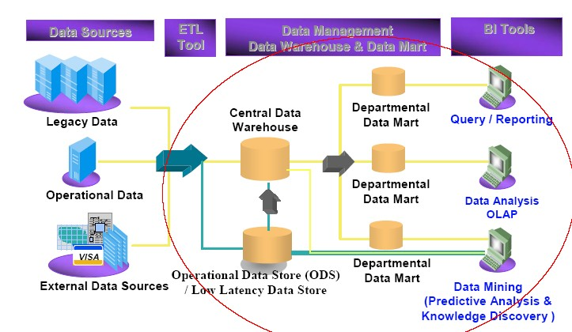
DATA WAREHOUSING AND ETL

Slide 10
ETL PROCESS

Slide 11
ETL – EXTRACT, TRANSFORM, LOAD
ETL is the process that organizations use to build consolidated data stores required for Business intelligence.
Extract
Extract data from heterogeneous source systems (relational , non- relational, flat files) and prepare for transformation / change
Transform
Change / conform source data to meet business requirements
Load
Load data into target data marts for reporting purposes.

Slide 12
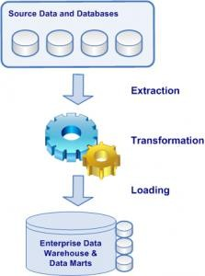
ETL PROCESS

Slide 13
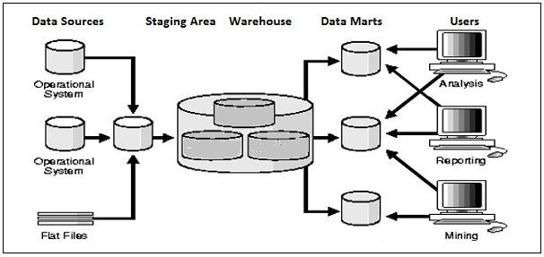
DATA EXTRACTION

Slide 14
DATA EXTRACTION
A staging area is required during ETL load. There are various reasons why staging area
is required.
The source systems are only available for specific period of time to extract data. This period of time is less than the total data-load time. Therefore, staging area allows you to extract the data from the source system and keeps it in the staging area before the time slot ends.
Staging area is required when you want to get the data from multiple data sources together or if you want to join two or more systems together. Data extractions time slot for different systems vary as per the time zone and operational hours.
Data extracted from source systems can be used in multiple data warehouse system, Operation Data stores, etc.
ETL allows you to perform complex transformations and requires extra area to store the data.

Slide 15
DATA TRANSFORMATION
In data transformation, you apply a set of functions on extracted data to load it into the target system. Data, which does not require any transformation is known as direct move or pass through data.
You can apply different transformations on extracted data from the source system. For example, you can perform customized calculations. If you want sum-of-sales revenue and this is not in database, you can apply the SUM formula during transformation and load the data.
For example, if you have the first name and the last name in a table in different columns, you can use concatenate before loading.

Slide 16
DATA LOADING
The final ETL step involves loading the transformed data into the destination target, which might be a database or data warehouse.
During Load phase, data is loaded into the end-target system and it can be a flat file or a Data
Warehouse system.

Slide 17
BODS OVERVIEW - ARCHITECTURE / TOOL & FUNCTIONS

Slide 18
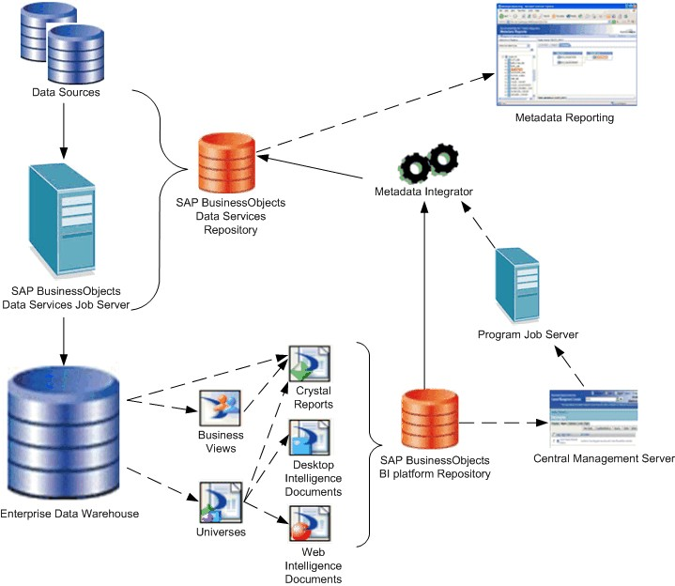
DATA SERVICES ARCHITECTURE

Slide 19
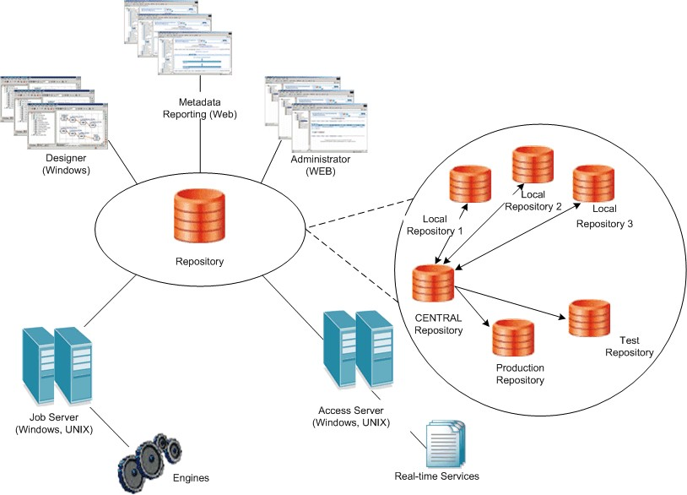
DISTRIBUTED ARCHITECTURE

Slide 20
DISTRIBUTED ARCHITECTURE
Components can be distributed across a number of computers to best support the traffic and connectivity requirements of the network
For development and testing, you can create a minimally distributed system designed.
developing
For production environment, design a highly distributed system that can scale with the demands.
Rules for distribution:
Engine processes run on the same computer as the Job Server that spawns them.
Adapters require a local Job Server.
Communication between a Web application, the Access Server, the Job Server, and real-time services occurs through TCP/IP connections specified by IP addresses (or host names) and port numbers.

Slide 21
DATA SERVICES COMPONENTS AND RELATIONSHIPS

Slide 22
DATA SERVICES PRODUCT COMPONENTS
The Data Services product consists of several components including
Designer
Job Server
Engine
Repository
Access Server
Administrator

Slide 23
DESIGNER
The Designer is a development tool with an easy-to-use graphical user interface.
It enables developers to define data management applications that consist of data mappings, transformations, and control logic.
Use the Designer to create applications containing work flows (job execution definitions) and data flows (data transformation definitions).
To use the Designer, create objects, then drag, drop, and configure them by selecting icons in flow diagrams, table layouts, and nested workspace pages.
The objects in the Designer represent metadata. The Designer interface allows you to manage metadata stored in a repository. From the Designer, you can also trigger the Job Server to run your jobs for initial application testing.

Slide 24
JOB SERVER
Job Server starts the data movement engine that integrates data from multiple heterogeneous sources, performs complex data transformations, and manages extractions and transactions from ERP systems and other sources.
The Job Server can move data in either batch or real-time mode and uses distributed query optimization, multi-threading, in-memory caching, in-memory data transformations, and parallel processing to deliver high data throughput and scalability.
While designing a job, you can run it from the Designer which tells the Job Server to run the job. The Job Server gets the job from its associated repository, then starts an engine to process the job.
In production environment, the Job Server runs jobs triggered by a scheduler or by a
real-time service managed by the Access Server.
In production environments, you can balance job loads by creating a Job Server Group (multiple Job Servers) which executes jobs according to overall system load.

Slide 25
ENGINE
When Data Services jobs are executed, the Job Server starts engine processes to perform data extraction, transformation, and movement.
The engine processes use parallel processing and in-memory data transformations to
deliver high data throughput and scalability.

Slide 26
REPOSITORY
Repository is a set of tables that hold user-created and predefined system objects, source and target metadata, and transformation rules
Each repository is associated with one or more Job Servers which run the jobs you create.
There are two types of repositories used commonly:
A local repository is used by an application designer to store definitions of objects (like projects, jobs, work flows, and data flows) and source/target metadata.
A central repository is an optional component that can be used to support multi-user development. The central repository provides a shared object library allowing developers to check objects in and out of their local repositories.

Slide 27
ACCESS SERVER
The SAP Business Objects Data Services Access Server is a real-time, request-reply message broker that collects message requests, routes them to a real-time service, and delivers a message reply within a user-specified time frame.
The Access Server queues messages and sends them to the next available real-time
service across any number of computing resources.
This approach provides automatic scalability because the Access Server can initiate additional real-time services on additional computing resources if traffic for a given real-time service is high.
You can configure multiple Access Servers.

Slide 28
MANAGEMENT CONSOLE
The Data Services product consists of several components including
Administrator
Impact and Lineage Analysis reports
Operational Dashboard reports
Auto Documentation reports
Data Validation
Data Quality reports

Slide 29
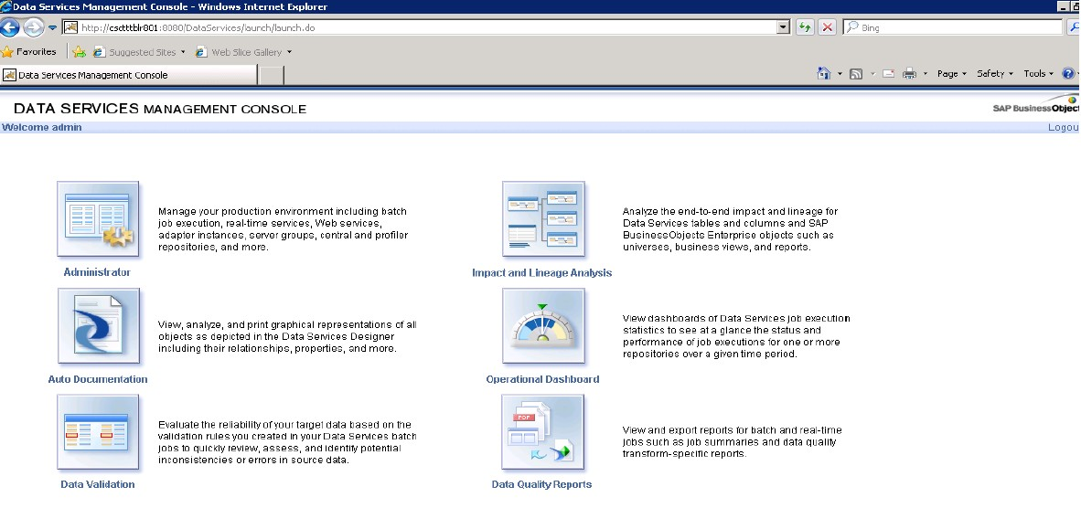
MANAGEMENT CONSOLE WINDOW OVERVIEW

Slide 30
ADMINISTRATOR
The Administrator provides browser-based administration of SAP Business Objects Data Services resources including:
Scheduling, monitoring, and executing batch jobs
Configuring, starting, and stopping real-time services
Configuring Job Server, Access Server, and repository usage
Configuring and managing adapters
Managing users
Publishing batch jobs and real-time services via Web services

Slide 31
IMPACT AND LINEAGE ANALYSIS REPORTS
Impact and Lineage Analysis reports include :
Data store Analysis
Universe analysis
Business View analysis
Report analysis
Dependency analysis

Slide 32
OPERATIONAL DASHBOARD REPORTS
Operational dashboard reports provide graphical depictions of SAP BusinessObjects Data Services job execution statistics.
This feedback allows you to view at a glance the status and performance of your job executions for one or more repositories over a given time period.
You can then use this information to streamline and monitor your job scheduling and management for maximizing overall efficiency and performance.

Slide 33
AUTO DOCUMENTATION REPORTS
Auto documentation reports provide a convenient and comprehensive way to create printed documentation for all of the objects you create in SAP BusinessObjects Data Services.
Auto documentation reports capture critical information for understanding your jobs so you can see at a glance the entire ETL process.
After creating a project, you can use Auto documentation reports to quickly create a PDF or Microsoft Word file that captures a selection of job, work flow, and/or data flow information including graphical representations and key mapping details.

Slide 34
DATA VALIDATION DASHBOARD
Data Validation dashboard reports provide graphical depictions that let you evaluate the reliability of your target data based on the validation rules you created in your SAP BusinessObjects Data Services batch jobs.
This feedback allows business users to quickly review, assess, and identify potential inconsistencies or errors in source data.

Slide 35
MANAGEMENT TOOLS

Slide 36
REPOSITORY MANAGER
The Repository Manager allows you to create, upgrade, and check the versions of local and central repositories.
There are three types of repositories:
Local repository
Central repository
Profiler repository

Slide 37
LOCAL REPOSITORY
A local repository is used by an application designer to store definitions of objects (like projects, jobs, work flows, and data flows) and source/target metadata.
CENTRAL REPOSITORY
A central repository is an optional component that can be used to support multi-user development.
The central repository provides a shared object library allowing developers to check objects in and out of their local repositories.
PROFILER REPOSITORY
The Data Profiler repository is a set of tables that holds information about your data that the Data Profiler generates.

Slide 38
CREATING REPOSITORY
You create a repository during installation.
You can create a repository at any time using the Repository Manager.
If you are creating a new repository, ensure that you created a database for the new repository to use.
From the Start menu, choose Programs > SAP Business Objects 4.2 > SAP
Business Objects Data Services > Data Services Repository Manager.
In the Repository Manager window, enter the database connection information for the repository and select Local for repository type.
Click Create. This adds the repository schema to the specified database.

Slide 39
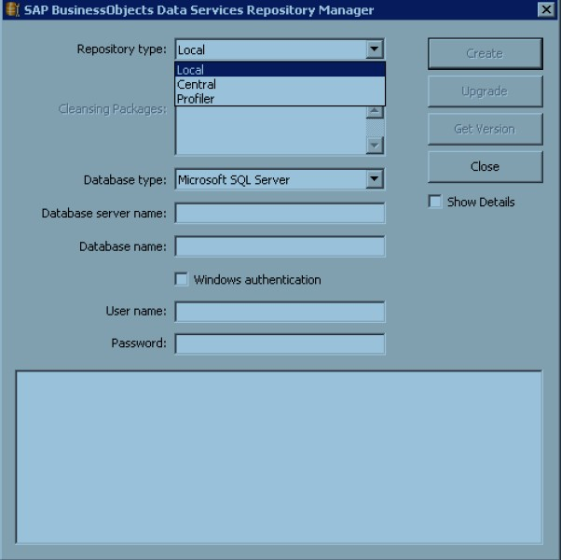
CREATING REPOSITORY

Slide 40
SERVER MANAGER
The Server Manager allows you to add, delete, or edit the properties of Job Servers and Access Servers.
It is automatically installed on each computer on which you install a Job Server or Access Server.
Use the Server Manager to define links between Job Servers and repositories.
You can link multiple Job Servers on different machines to a single repository (for load balancing) or each Job Server to multiple repositories (with one default) to support individual repositories (separating test from production, for example).
You can also specify a Job Server as SNMP-enabled.
The Server Manager is also where you specify SMTP server settings for the smtp_toemail function..

Slide 41
CREATING JOB SERVER
You create a job server during installation.
You can create a job server at any time using the Server Manager.
From the Start menu, choose Programs > SAP Business ObjectsXI 3.2 > SAP
Business Objects Data Services > Data Services Server Manager.

Slide 42
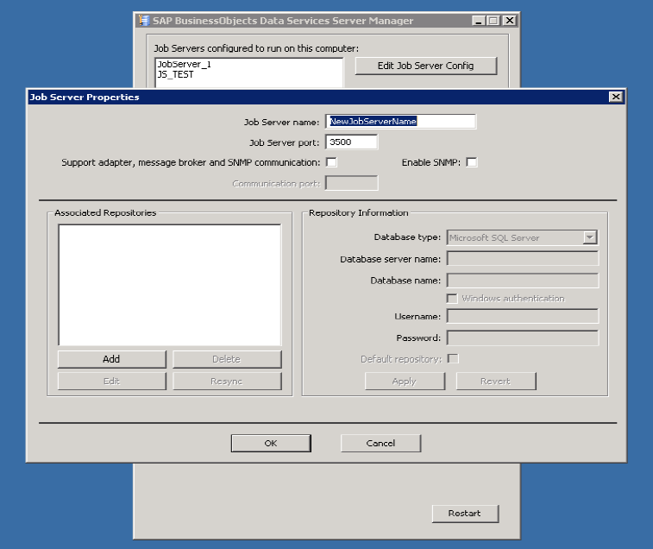
CREATING JOB SERVER

Slide 43
ASSOCIATING THE REPOSITORY WITH A JOB SERVER:
Each repository must be associated with at least one Job Server, which is the process that starts jobs.
When running a job from a repository, you select one of the associated repositories.
In production environments, you can balance loads appropriately.
You can link any number of repositories to a single Job Server.
The same Job Server can run jobs stored on multiple repositories.
You define a Job Server and link it to a repository during installation.
You can define or edit Job Servers or links between repositories and Job Servers at any time using the Server Manager.

Slide 44
DIFFERENCE BETWEEN ETL / ELT
ETL
Extract, Transform, and Load (ETL) is a process that involves extracting data from outside sources, transforming it to fit operational needs (sometimes using staging tables), then loading it into the end target database or data warehouse.
This approach is reasonable as long as many different databases are involved in your data warehouse landscape
ELT
Extract, Load, Transform (ELT) is a process where data is extracted for the source, then loaded into a staging table in the database, transforming it where it sits in the database and then loading it into the target database or data warehouse.
When the data is extracted from the source into the staging tables, it is a raw copy, meaning you keep the column names the same as in the source
database and you don’t convert data, calculate new data fields, etc.

Slide 45
THANK YOU

